Slide 1

Data Extraction and Model Stealing
姜育刚，马兴军，吴祖煊

Slide 2
Recap: week 7
A Brief History of Backdoor Learning
Backdoor Attacks
Backdoor Defenses
Future Research

Slide 3
This Week
Data Extraction Attack & Defense
Model Stealing Attack
Future Research

Slide 4
This Week
Data Extraction Attack & Defense
Model Stealing Attack
Future Research

Slide 5
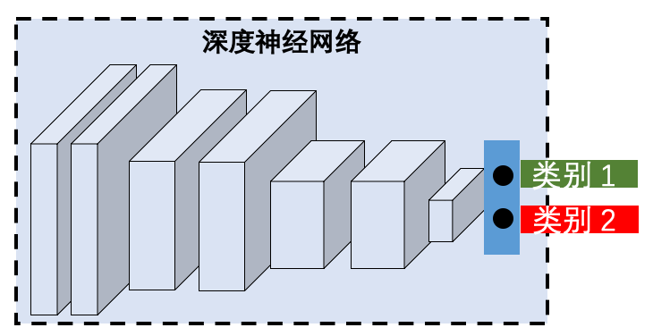
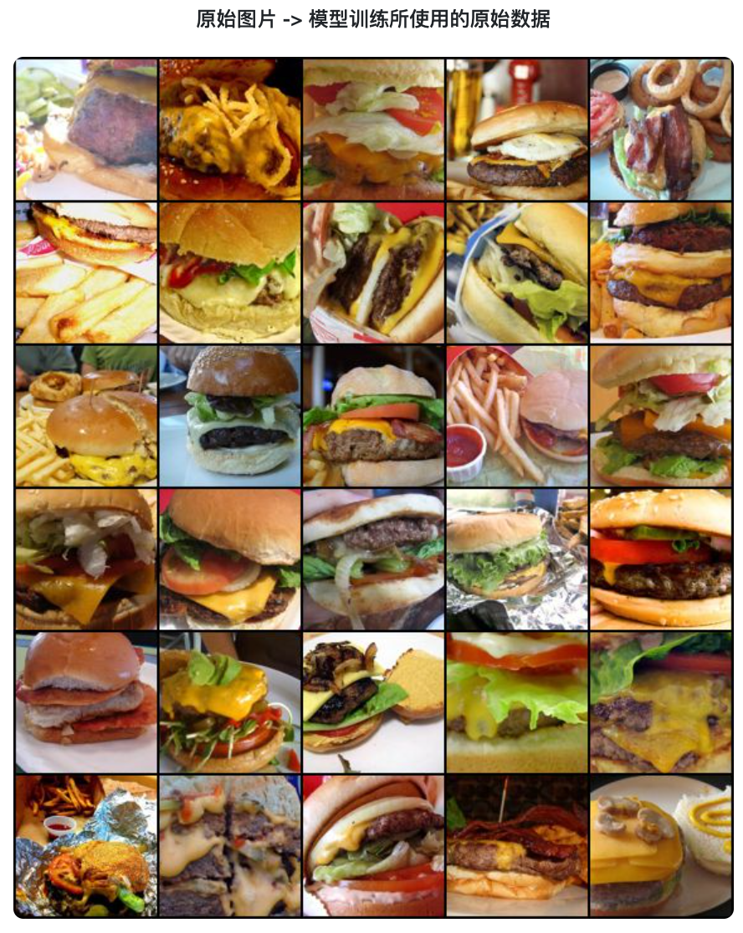
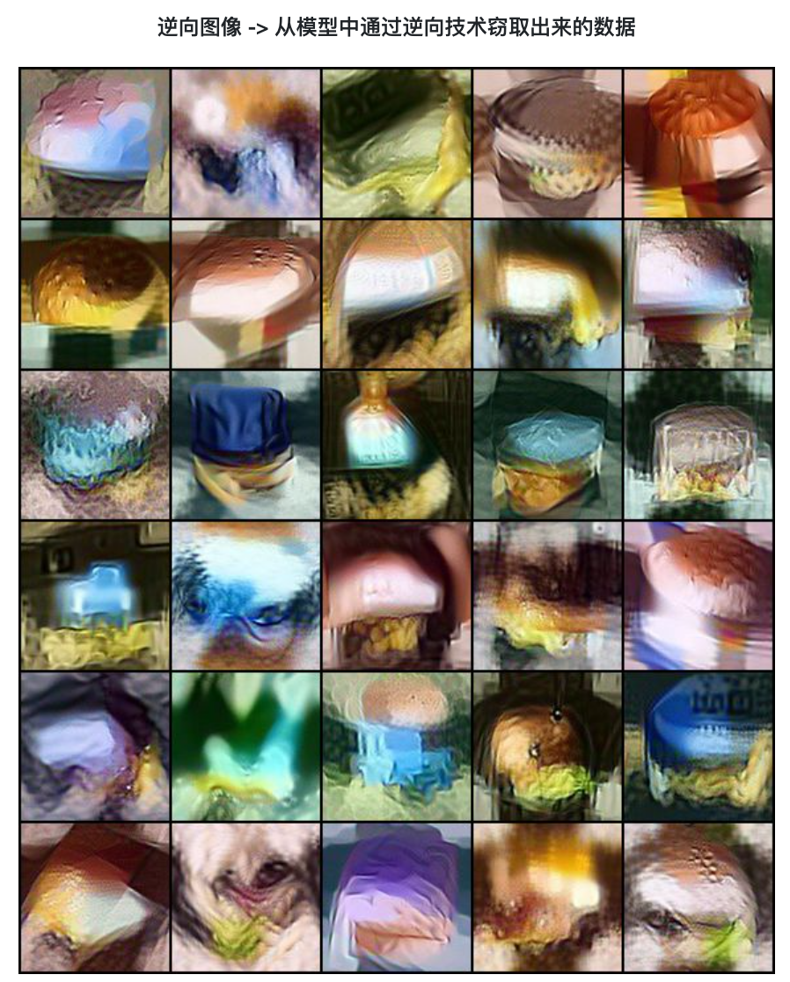
Data Extraction Attack
通过模型逆向得到训练数据
https://tech.openeglab.org.cn:8001/dss/imageClassify

Slide 6
Terminology
The following terms describe the same thing:
Data Extraction Attack
Data Stealing Attack
Training Data Extraction Attack
Model Memorization Attack
Model Inversion Attack

Slide 7
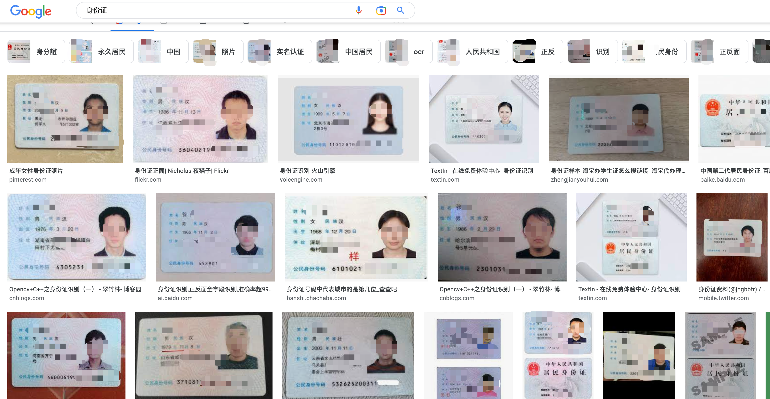
Security Threats
Personal Info Leakage
Sensitive Info Leakage
Threats to National Security
Illegal Data Trading
…
My social security number is 078-

Slide 8
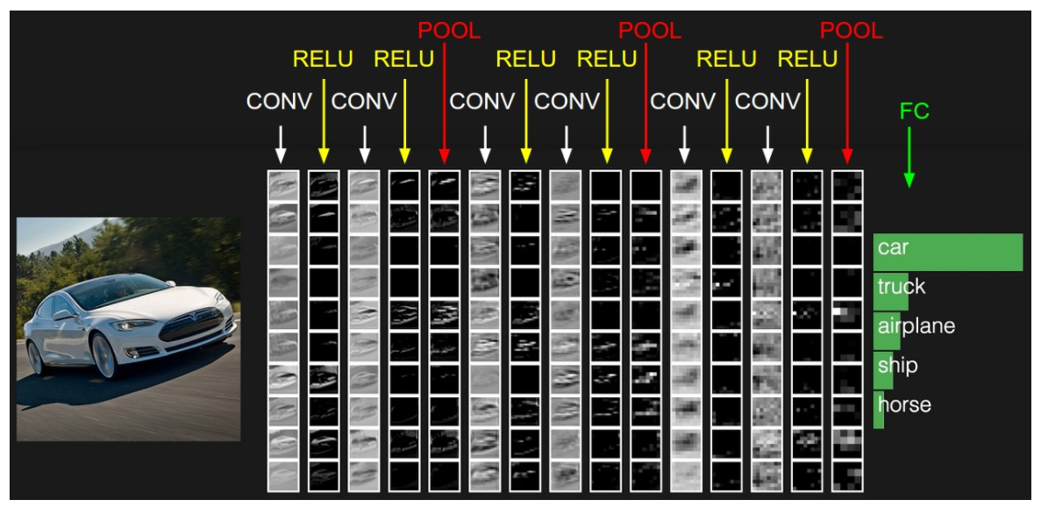
Memorization of DNNs
Evidence 1: DNN learns different levels of representations

Slide 9
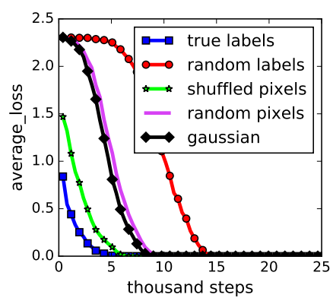
Memorization of DNNs
Evidence 2: DNN can memorize random labels/pixels
真实标签
随机标签
乱序像素
随机像素
高斯噪声
Zhang, Chiyuan, et al. “Understanding deep learning requires rethinking generalization.” ICLR 2017.

Slide 10
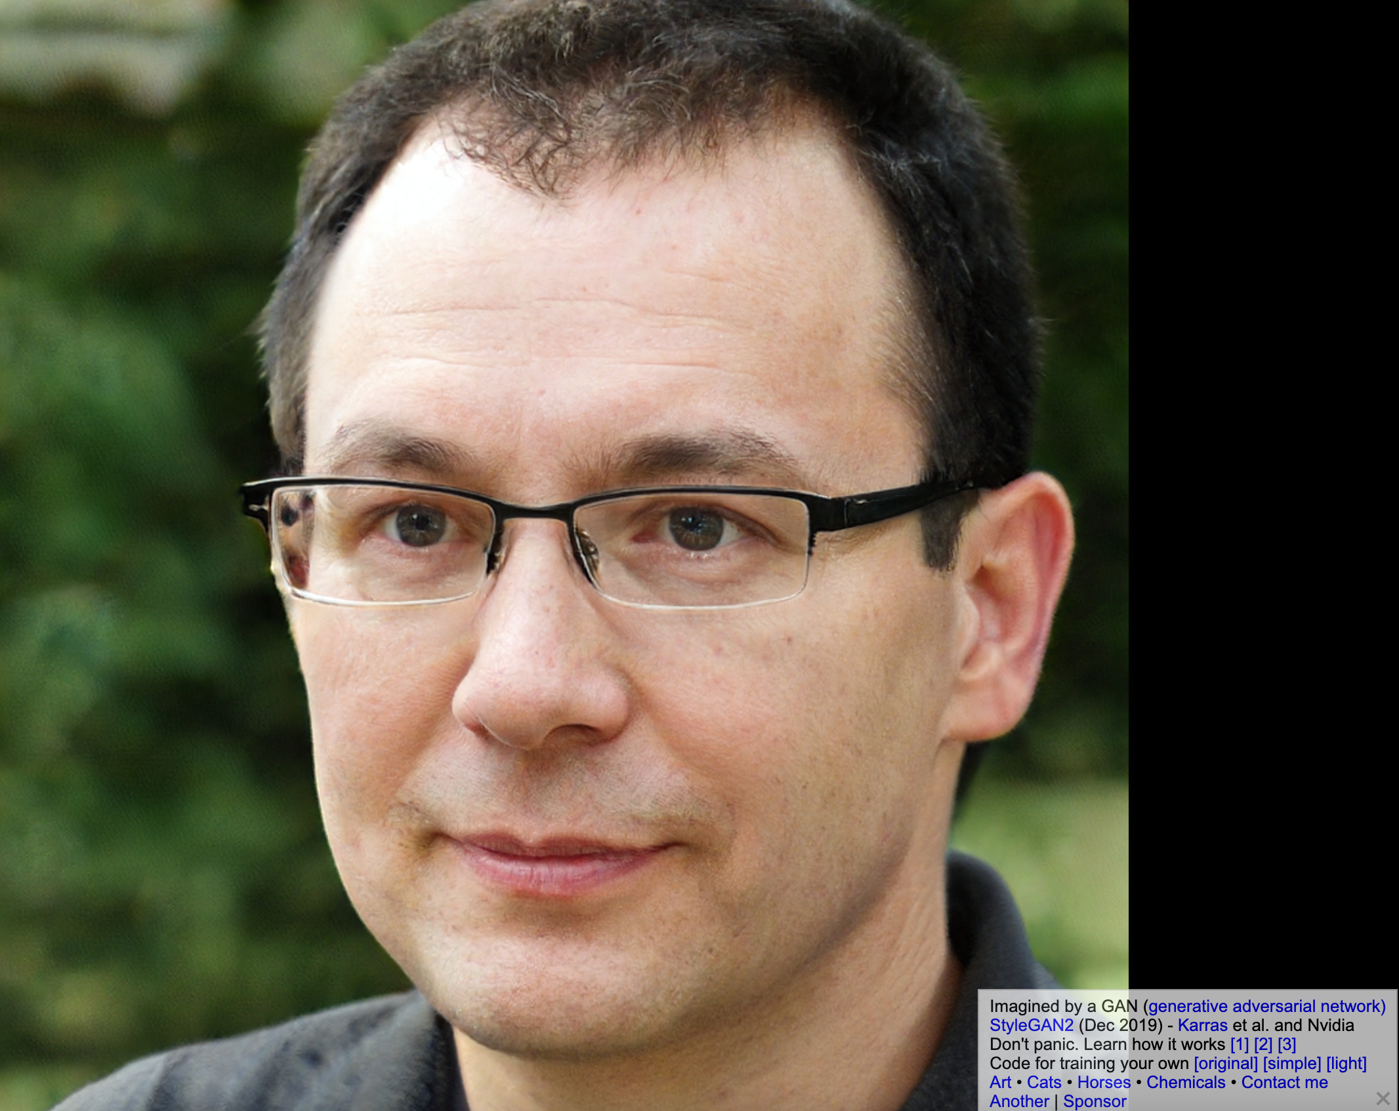
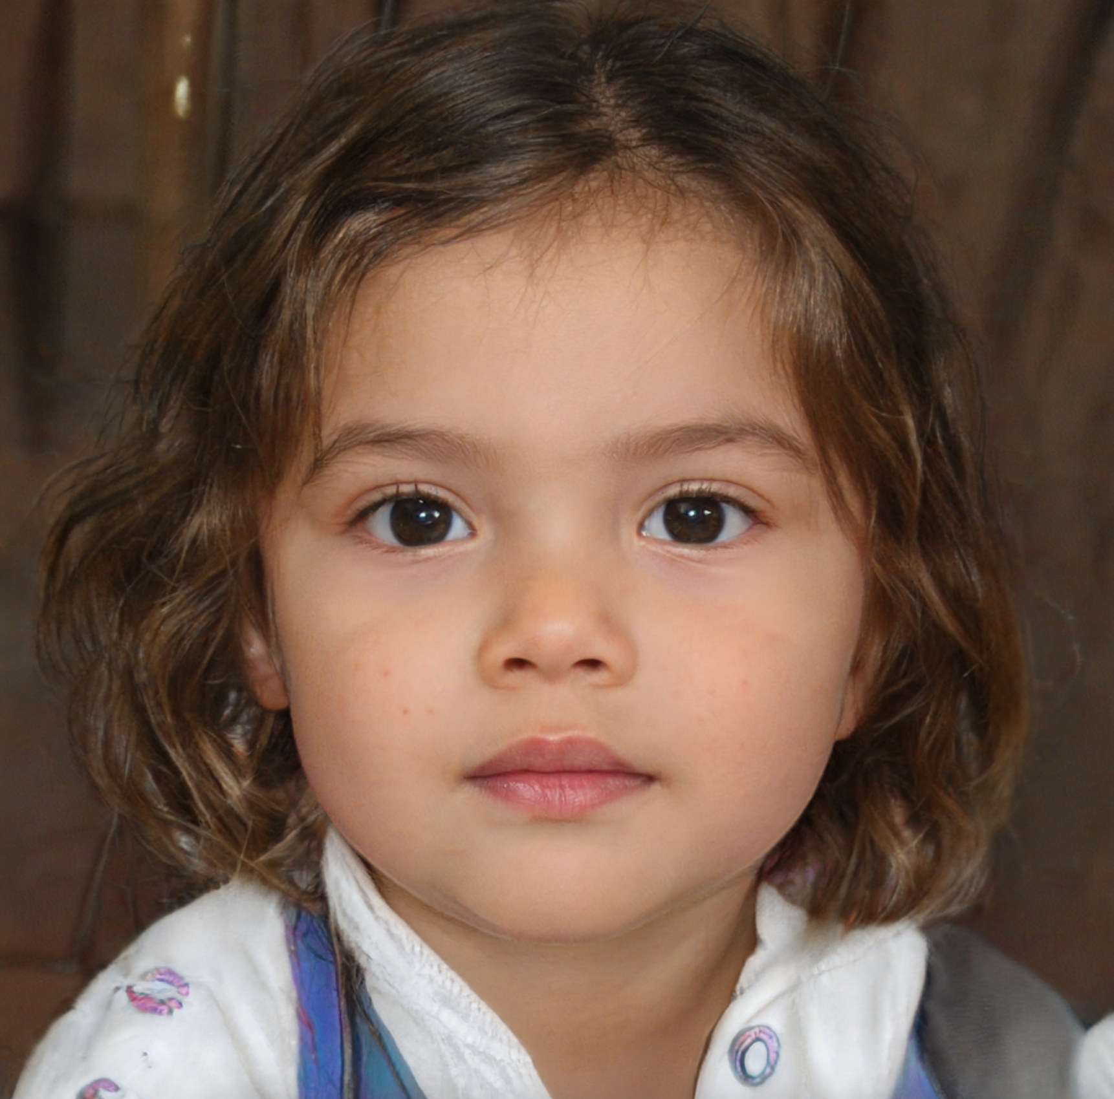
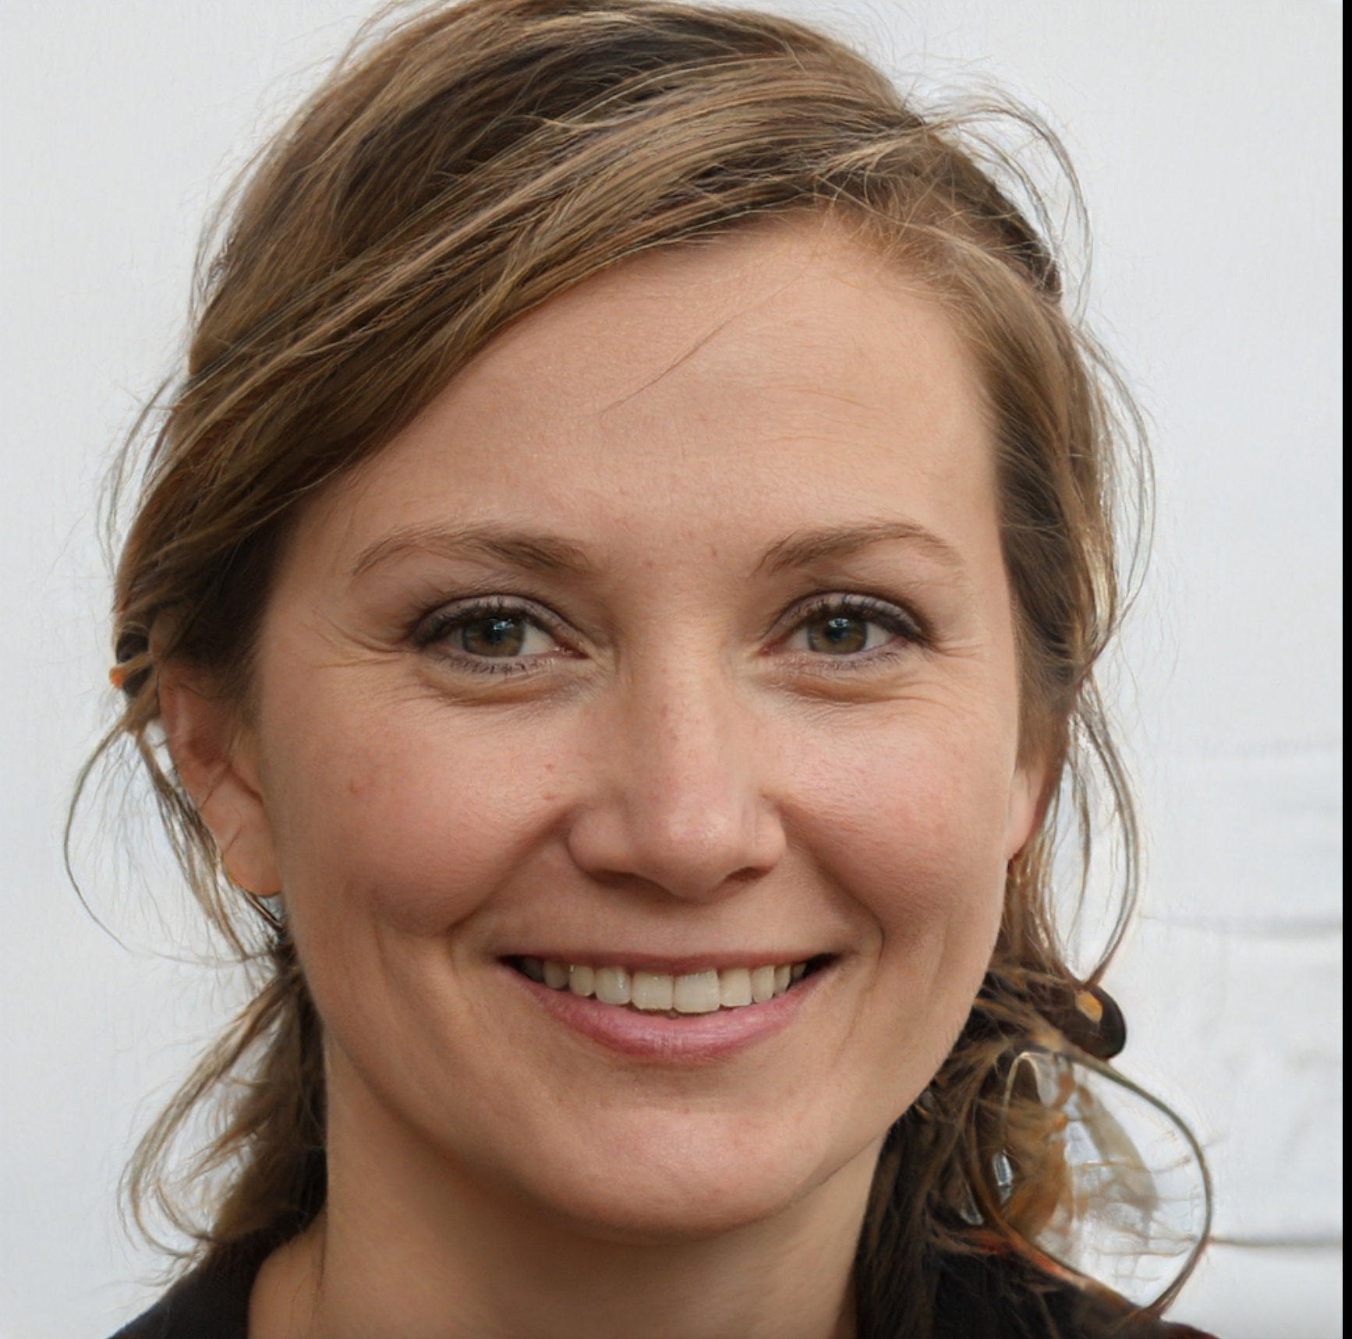
Memorization of DNNs
Evidence 3: The success of GANs and diffusion models
https://thispersondoesnotexist.com/; https://thisartworkdoesnotexist.com/

Slide 11
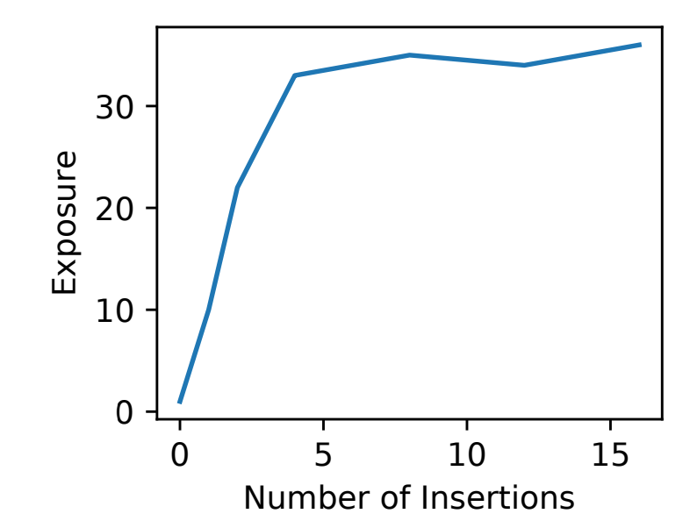
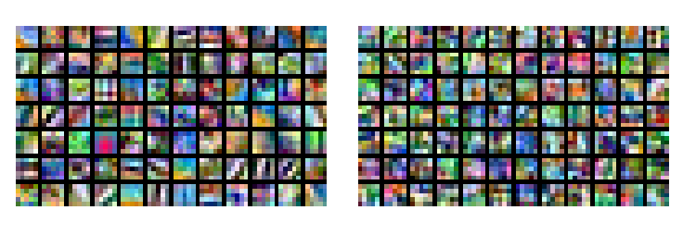
Intended vs. Unintended Memorization
Intended Memorization
Task-related
Statistics
Inputs and Labels
Unintended Memorization
Task-irrelevant but memorized
Even appear only a few times
出现4次就能全记住
第一层Filter
正常CIFAR-10
第一层Filter
随机标注CIFAR-10
自然语言翻译模型记忆：
“我的社保号码是 xxxx”
Arpit et al. “A closer look at memorization in deep networks.” ICML, 2017. Carlini et al. “The secret sharer: Evaluating and testing unintended memorization in neural networks.” USENIX Security, 2019.

Slide 12
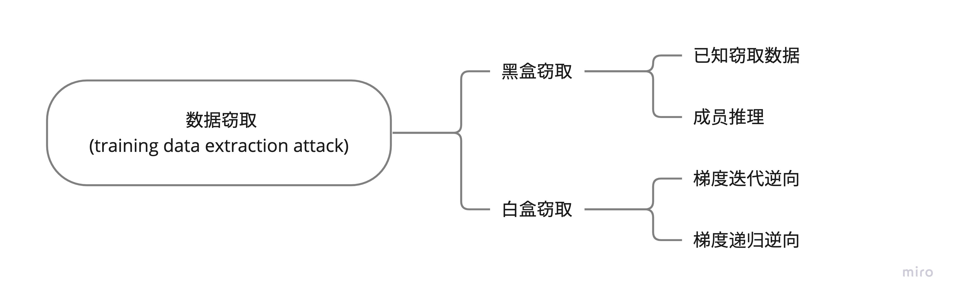
现有数据窃取攻击

Slide 13
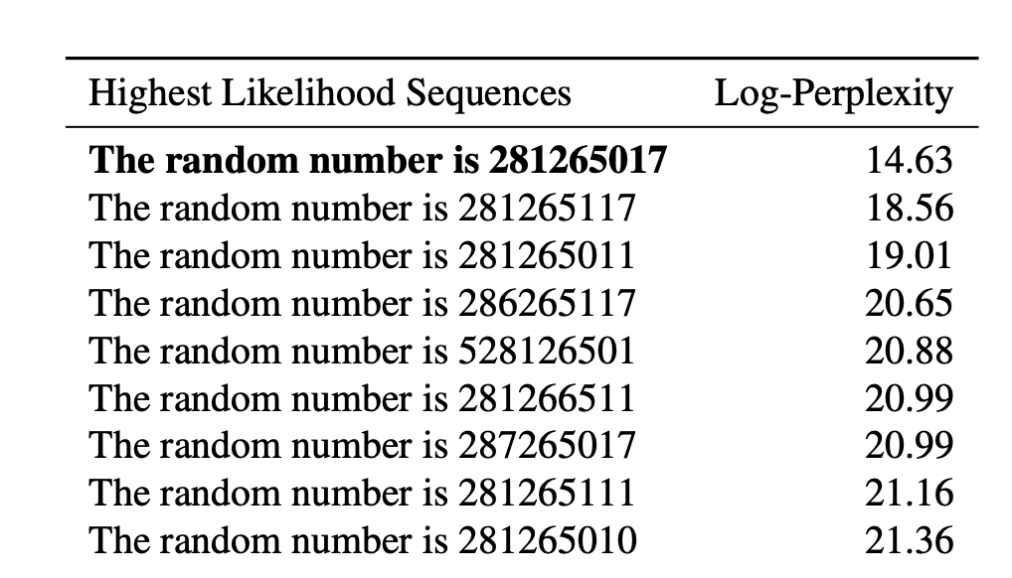
黑盒窃取
意外记忆测试和量化：’先兆’
主动测试：
煤矿里的金丝雀
“随机号码为****”
“我的社保号码为****”
主动注入，然后先兆数据在语言模型中的“曝光度”（Exposure）
Carlini et al. “The secret sharer: Evaluating and testing unintended memorization in neural networks.” USENIX Security, 2019.

Slide 14
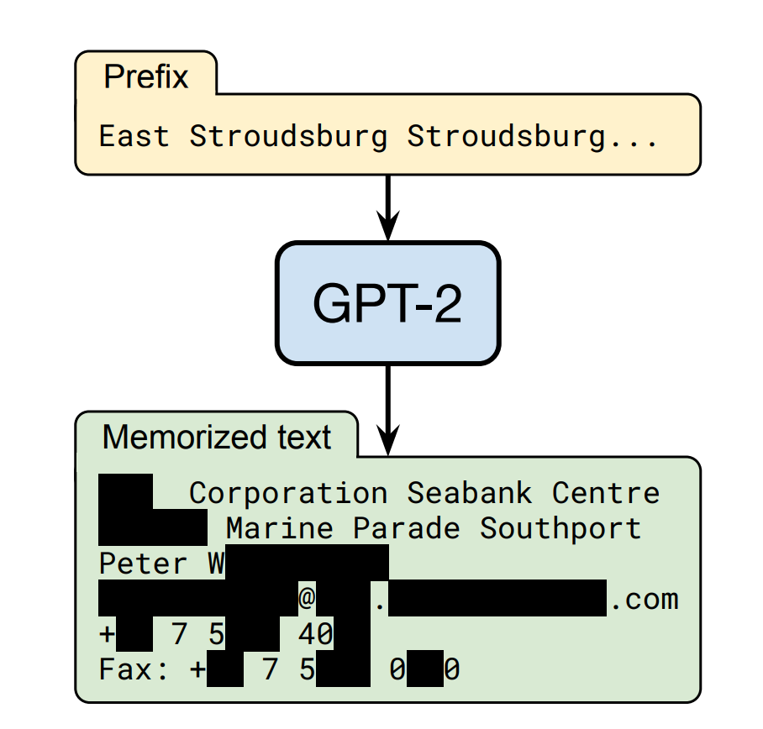
黑盒窃取
训练数据萃取攻击
Training Data Extraction Attack
针对通用语言模型：
逆向出大量的：名字、手机号、邮箱、社保号等
大模型比小模型更容易记住这些信息
即使只在一个文档里出现也能被记住
Carlini, Nicholas, et al. “Extracting training data from large language models.” USENIX Security, 2021.

Slide 15
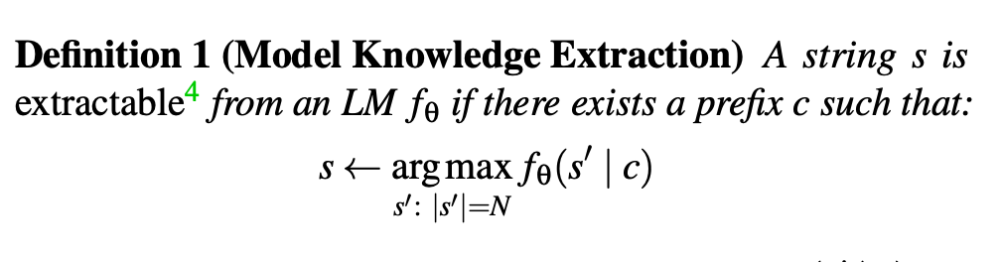
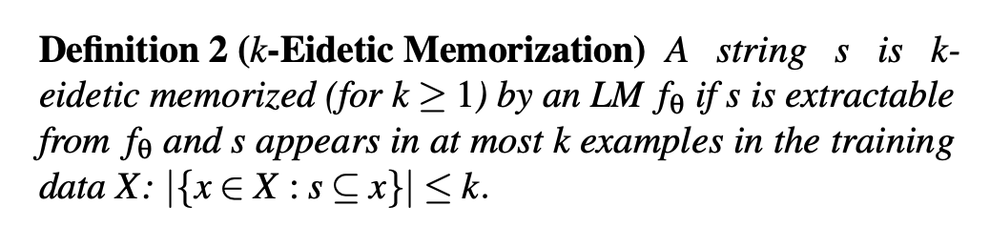
Definition of Memorization
模型知识提取
k-逼真记忆
Carlini, Nicholas, et al. “Extracting training data from large language models.” USENIX Security, 2021.

Slide 16
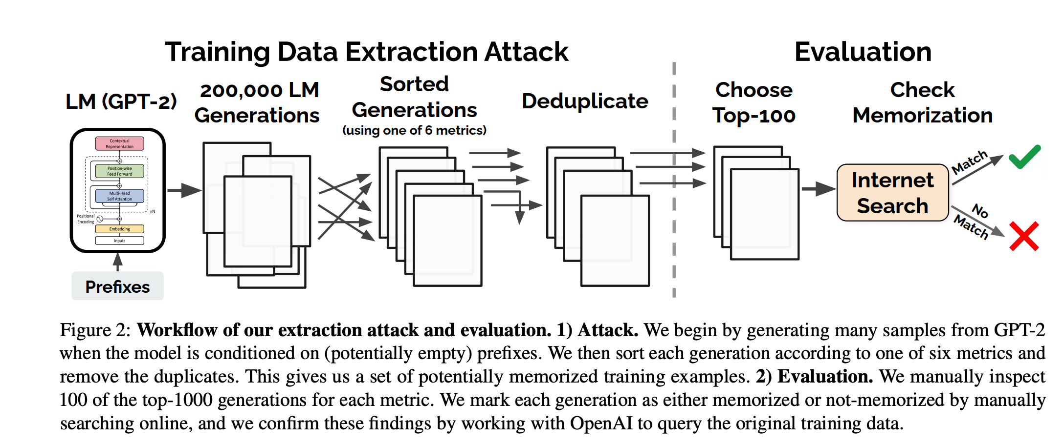
攻击步骤
步骤1：生成大量文本；步骤2：文本筛选和确认
Carlini, Nicholas, et al. “Extracting training data from large language models.” USENIX Security, 2021.

Slide 17
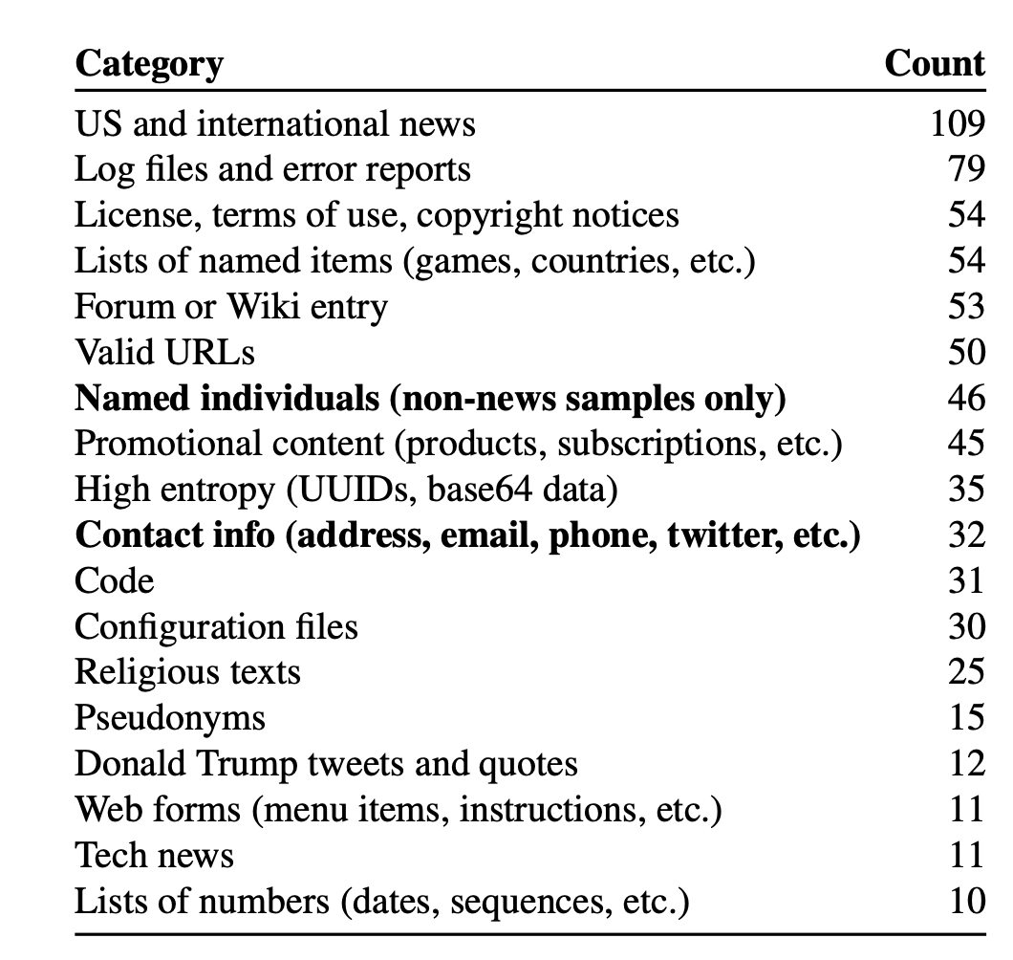
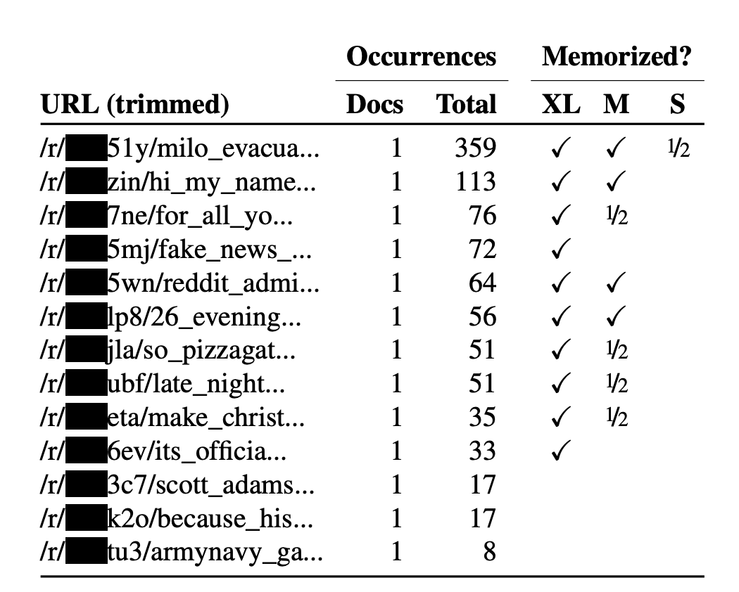
实验结果
只在一个文档里出现的记忆
模型越大记忆越强
604条“意外”记忆

Slide 18
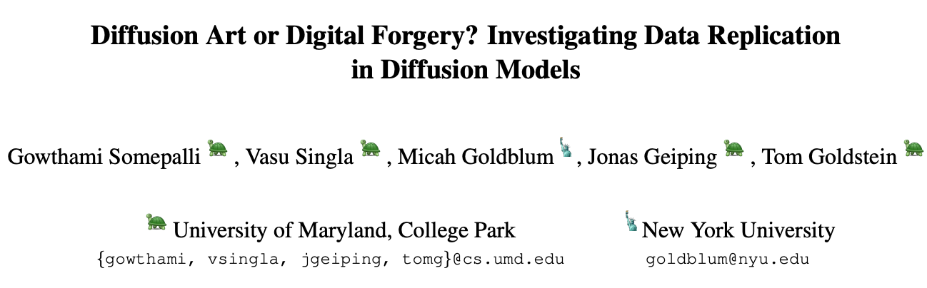

Memorization of Diffusion Models
生成的：
原始的：
美国马里兰大学和纽约大学联合研究发现，生成扩散模型会记忆原始训练数据，导致在特定文本提示下，泄露原始数据

Slide 19
Memorization of Diffusion Models
Definition of Replication:
We say that a generated image has replicated content if it contains an object (either in the foreground or background) that appears identically in a training image, neglecting minor variations in appearance that could result from data augmentation.
Somepalli, Gowthami, et al. "Diffusion art or digital forgery? investigating data replication in diffusion models." CVPR. 2023.

Slide 20
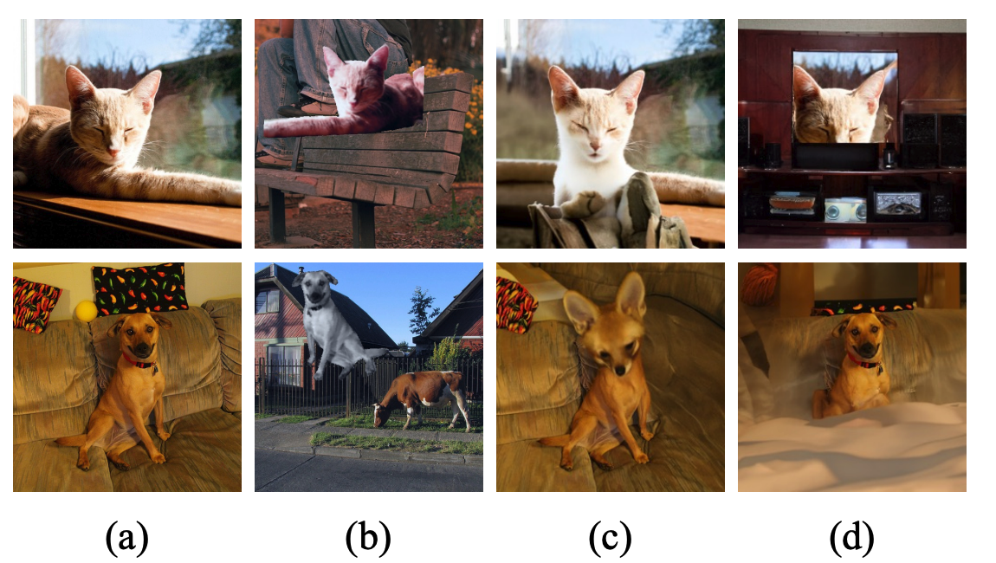
Memorization of Diffusion Models
Create Synthetic and Real Datasets
Existing image retrieval datasets:
Oxford
Paris
INSTRE
GPR1200
Original
Segmix
Diagonal
Outpainting
Patch
Outpainting
Somepalli, Gowthami, et al. "Diffusion art or digital forgery? investigating data replication in diffusion models." CVPR. 2023.

Slide 21
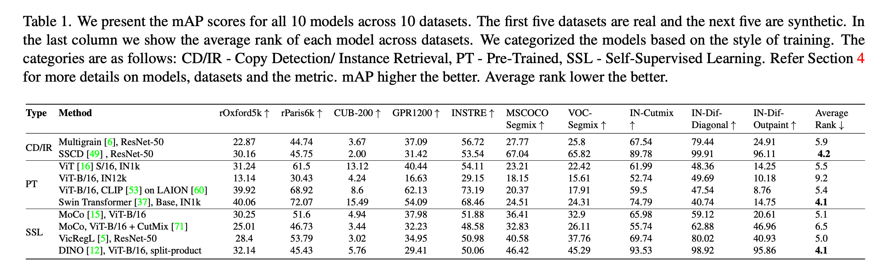
Memorization of Diffusion Models
Train Image Retrieval Models
Somepalli, Gowthami, et al. "Diffusion art or digital forgery? investigating data replication in diffusion models." CVPR. 2023.

Slide 22
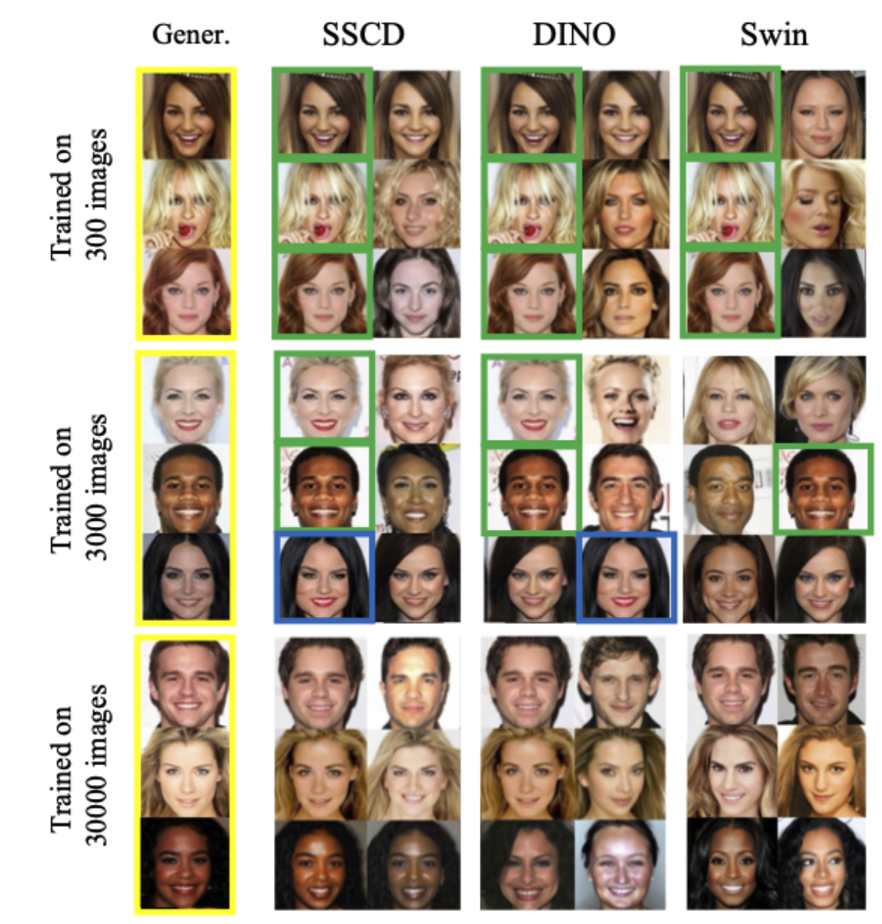
Memorization of Diffusion Models
Similarity metric:
inner product
token-wise inner product
Diffusion model: DDPM
Dataset: Celeb-A
The top-2 matches of diffusion models trained on 300, 3000, and 30000 images (the full set is 30000).
Results:
Green: copy
Blue: close but no exact copy
Others: similar but not the same
Somepalli, Gowthami, et al. "Diffusion art or digital forgery? investigating data replication in diffusion models." CVPR. 2023.

Slide 23
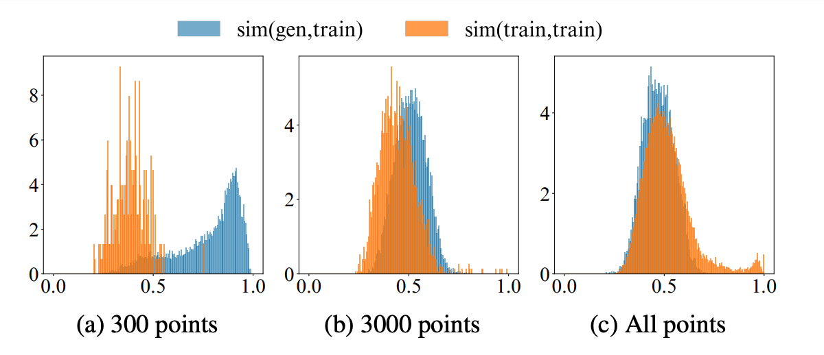
Memorization of Diffusion Models
数据越少Copy越多
Gen-train vs train-train similarity score distribution
Somepalli, Gowthami, et al. "Diffusion art or digital forgery? investigating data replication in diffusion models." CVPR. 2023.

Slide 24
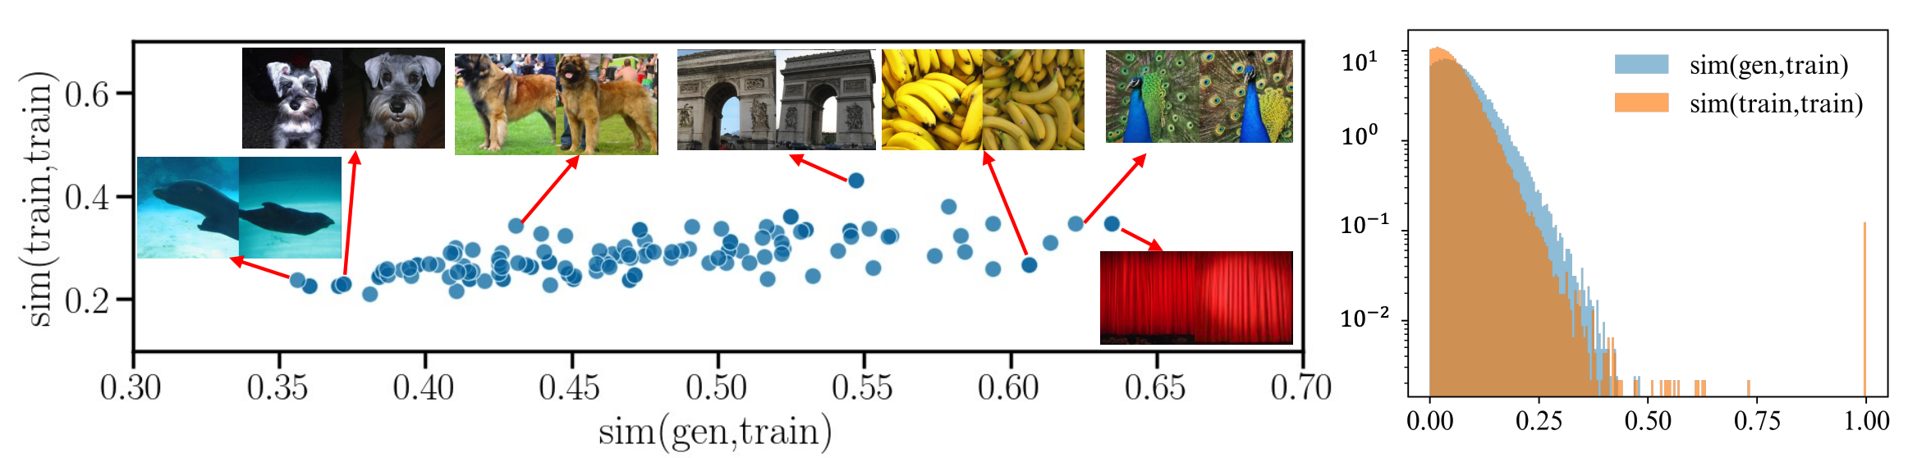
Memorization of Diffusion Models
Case study: ImageNet LDM
Many close copy but no exact match (similarity score <0.65)
Most similar: theater curtain, peacock, and bananas
Least similar: sea lion, bee, and swing
Somepalli, Gowthami, et al. "Diffusion art or digital forgery? investigating data replication in diffusion models." CVPR. 2023.

Slide 25
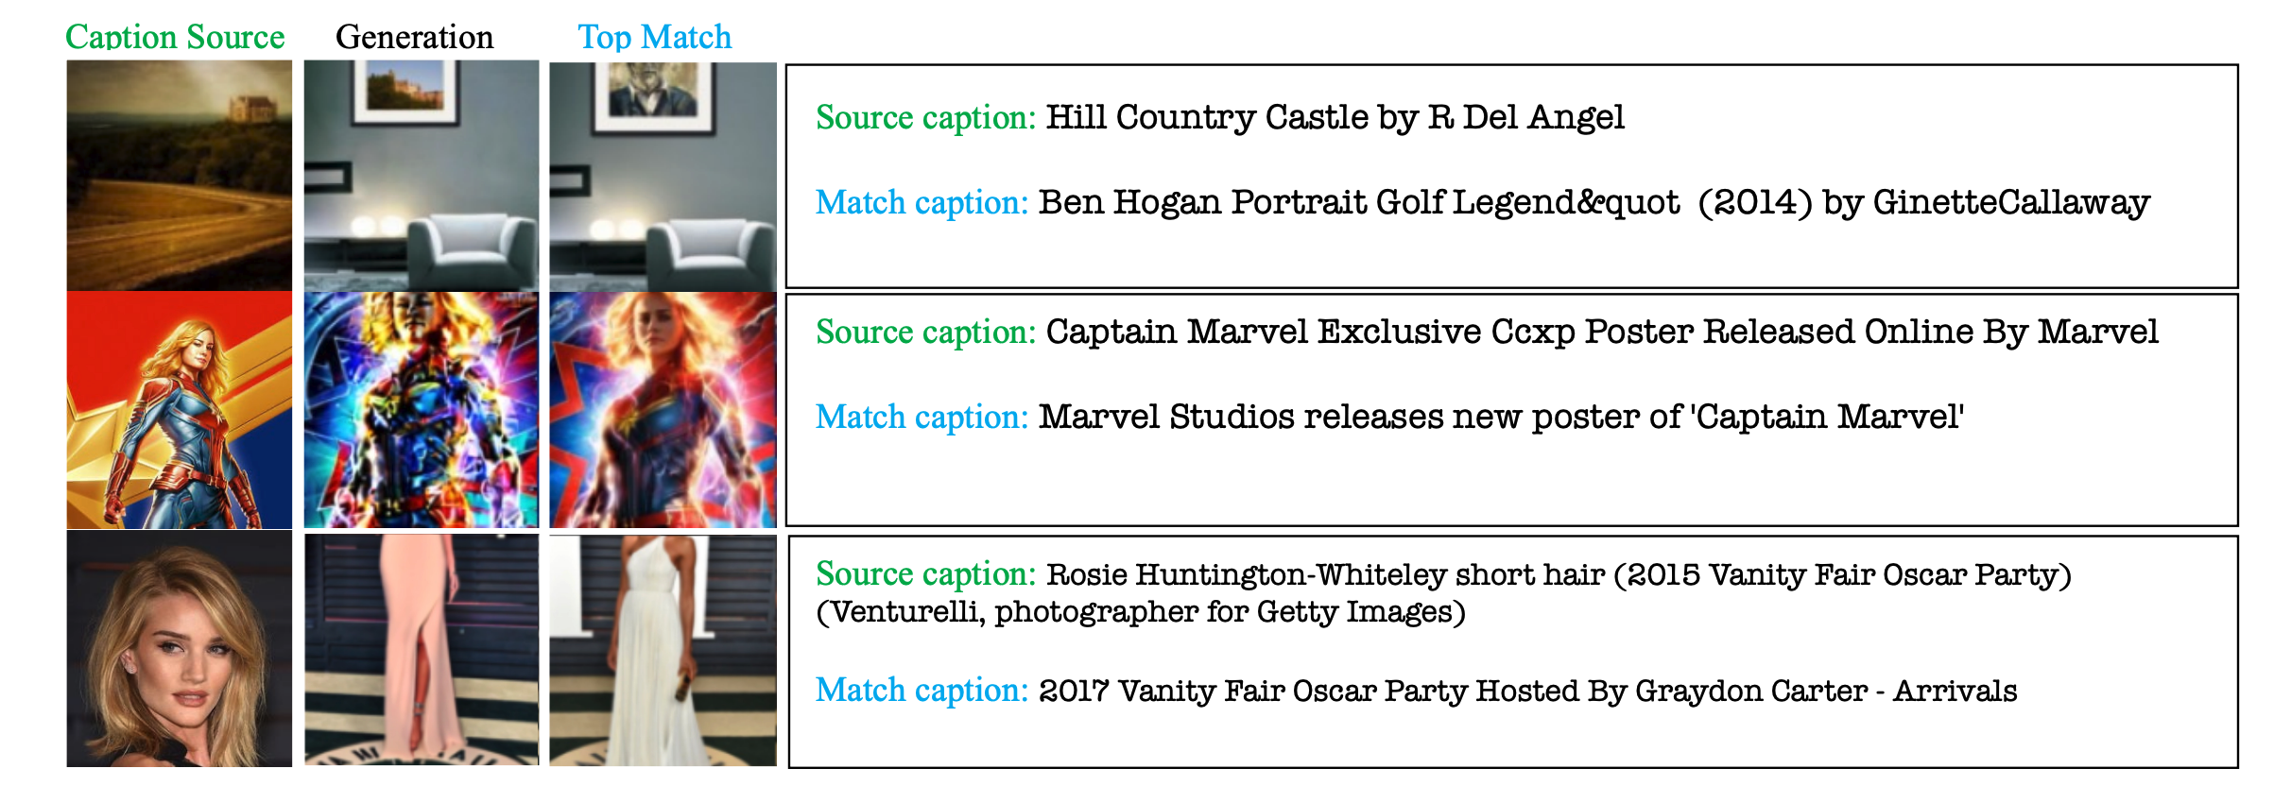
Memorization of Diffusion Models
Case study: Stable Diffusion
LAION Aesthetics v2 6+: 12M images
Random select 9000 images as source and use their captions to prompt
Somepalli, Gowthami, et al. "Diffusion art or digital forgery? investigating data replication in diffusion models." CVPR. 2023.

Slide 26

Memorization of Diffusion Models
Case study: Stable Diffusion
Key words
Some keywords (those in red) are associated with certain fixed patterns.
Somepalli, Gowthami, et al. "Diffusion art or digital forgery? investigating data replication in diffusion models." CVPR. 2023.

Slide 27
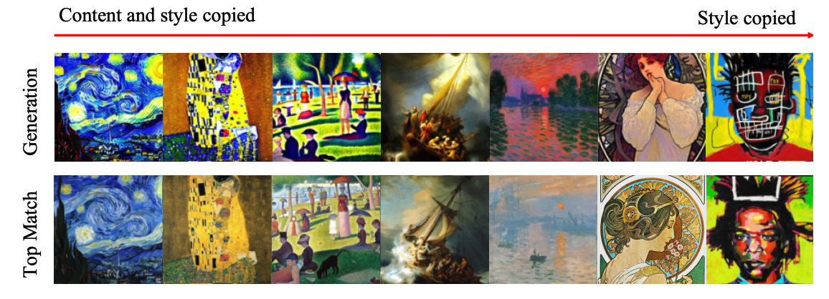
Memorization of Diffusion Models
Case study: Stable Diffusion
Style copying using text prompt: <Name of the painting> by <name of the artist>
Somepalli, Gowthami, et al. "Diffusion art or digital forgery? investigating data replication in diffusion models." CVPR. 2023.

Slide 28
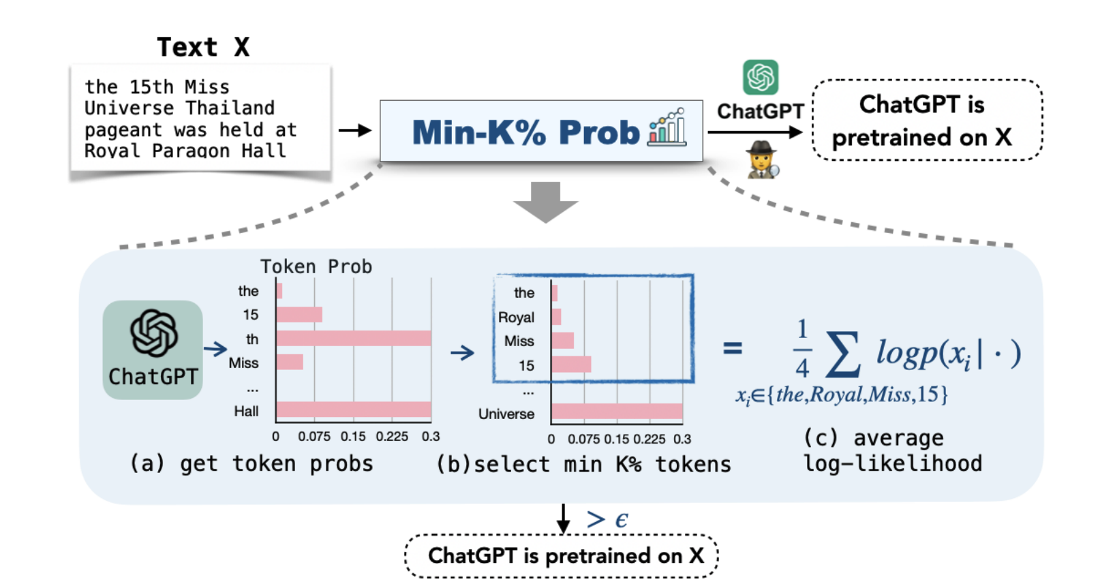
Memorization of Large Language Models (LLMs)
Pretraining data detection
MIN-K% PROB
Shi, Weijia, et al. "Detecting Pretraining Data from Large Language Models." arXiv preprint arXiv:2310.16789 (2023).

Slide 29
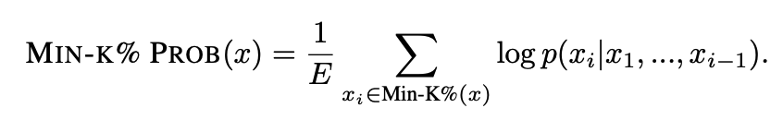
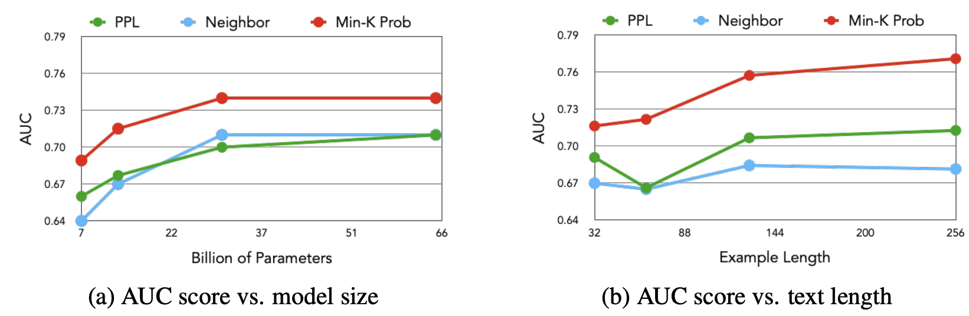
Memorization of Large Language Models (LLMs)
Detection on WIKIMIA
A dynamic benchmark: WIKIMIA
Shi, Weijia, et al. "Detecting Pretraining Data from Large Language Models." arXiv preprint arXiv:2310.16789 (2023).

Slide 30
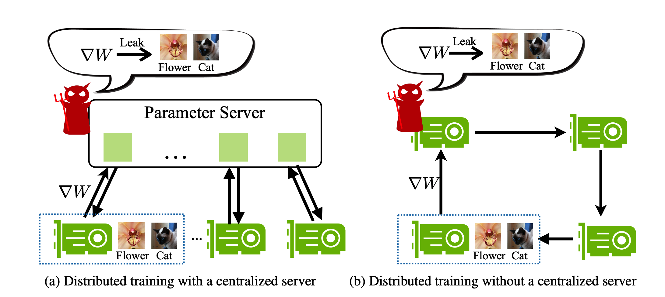
白盒窃取
白盒窃取需要利用梯度信息，也称梯度逆向攻击（Gradient Inversion Attack）
针对梯度共享的训练：
分布式训练
联邦学习
并行训练
无中心化训练
两种分布式训练范式

Slide 31
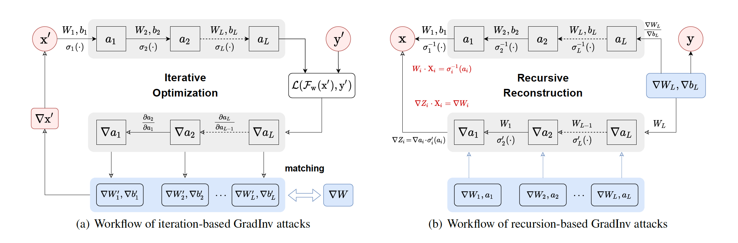
白盒窃取
白盒窃取需要利用梯度信息，也称梯度逆向攻击（Gradient Inversion Attack）
逼近
反推
迭代逆向
（逐层）递归逆向
Zhang et al. “A Survey on Gradient Inversion: Attacks, Defenses and Future Directions.” IJCAI 2022.

Slide 32
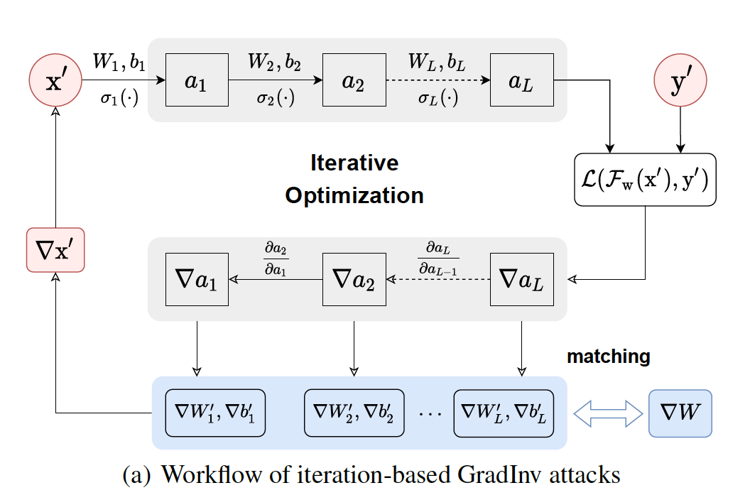
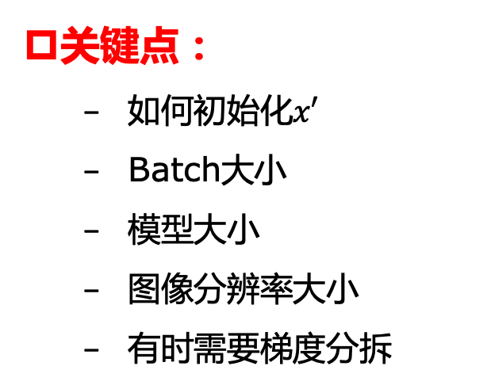
白盒窃取：迭代逆向
迭代逆向：通过构造数据来接近真实梯度
一次前传
关键点：
如何初始化$x′$
Batch大小
模型大小
图像分辨率大小
有时需要梯度分拆
两次后传
真实梯度，假设已知
生成数据产生的梯度
Zhang et al. “A Survey on Gradient Inversion: Attacks, Defenses and Future Directions.” IJCAI 2022.

Slide 33
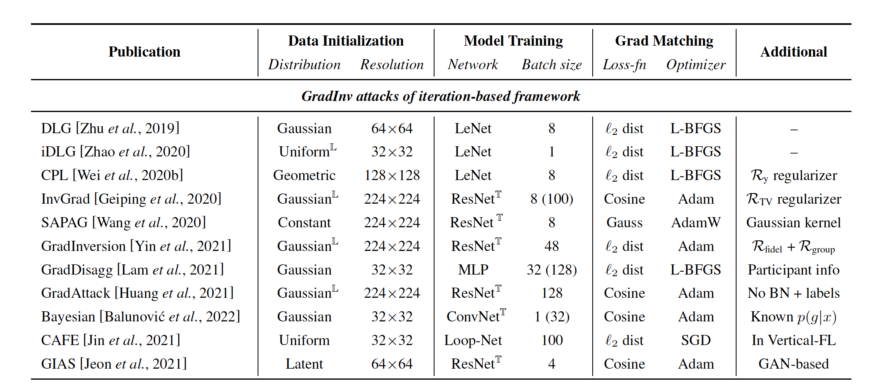
白盒窃取：迭代逆向
已有工作汇总
Zhang et al. “A Survey on Gradient Inversion: Attacks, Defenses and Future Directions.” IJCAI 2022.

Slide 34
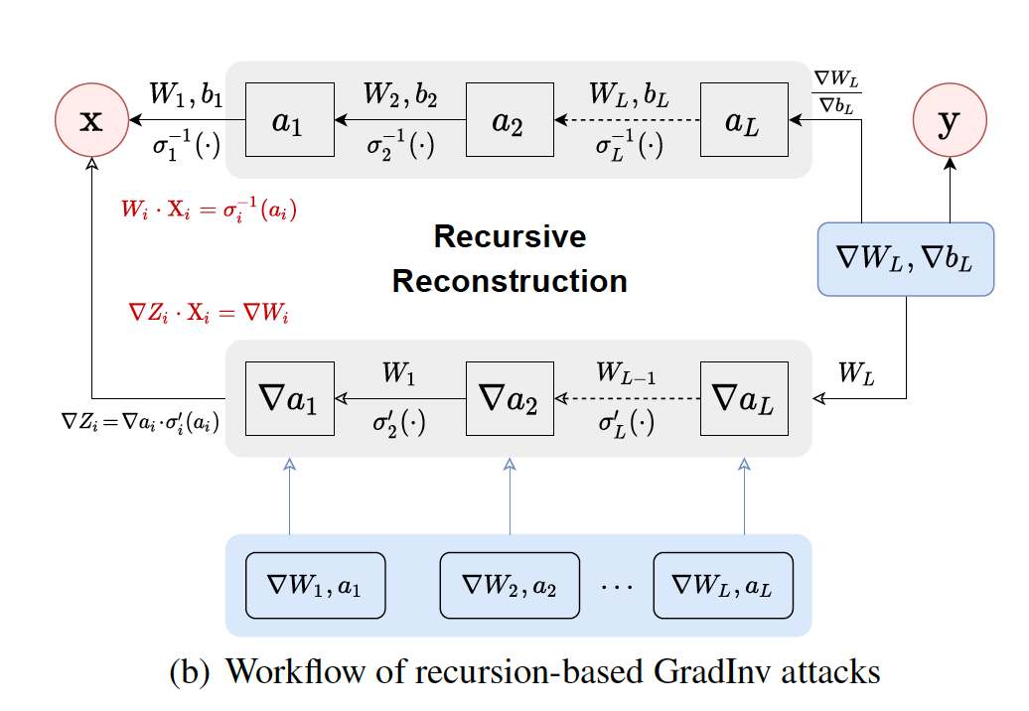
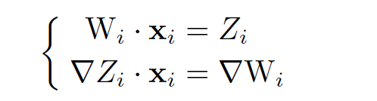
白盒窃取：递归逆向
递归逆向：基于真实梯度追层逆向推导
关键点：
图像大小（32x32）
Batch大小（大多为1）
模型大小
真实梯度，已知
Zhang et al. “A Survey on Gradient Inversion: Attacks, Defenses and Future Directions.” IJCAI 2022.

Slide 35
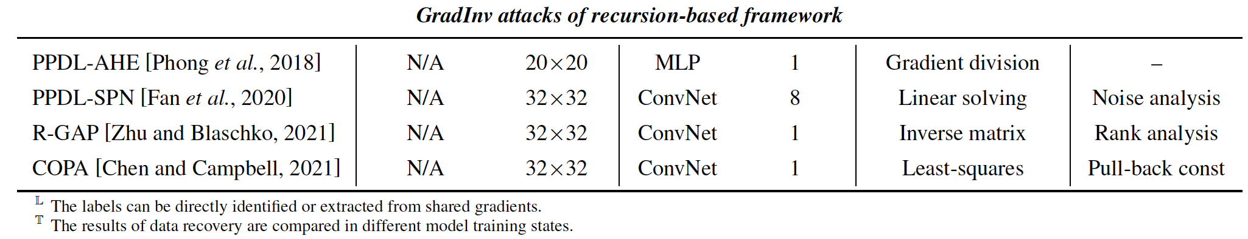
白盒窃取：递归逆向
已有工作汇总
Zhang et al. “A Survey on Gradient Inversion: Attacks, Defenses and Future Directions.” IJCAI 2022.

Slide 36
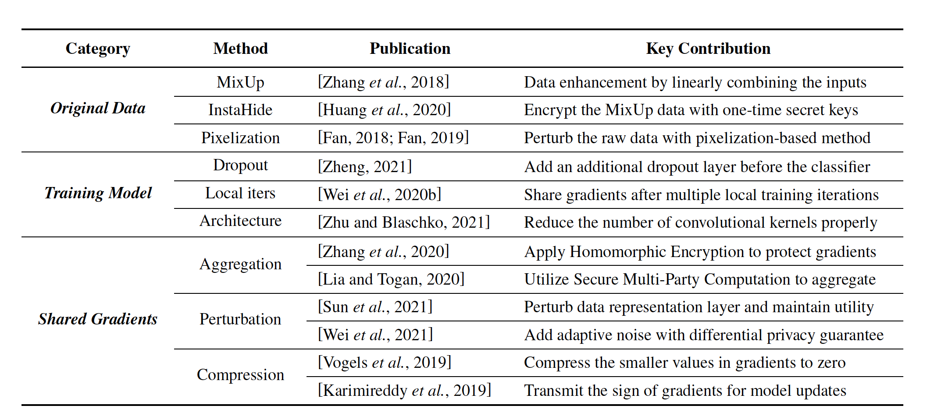
白盒防御
已有工作汇总
Zhang et al. “A Survey on Gradient Inversion: Attacks, Defenses and Future Directions.” IJCAI 2022.

Slide 37
This Week
Data Extraction Attack & Defense
Model Stealing Attack
Future Research

Slide 38

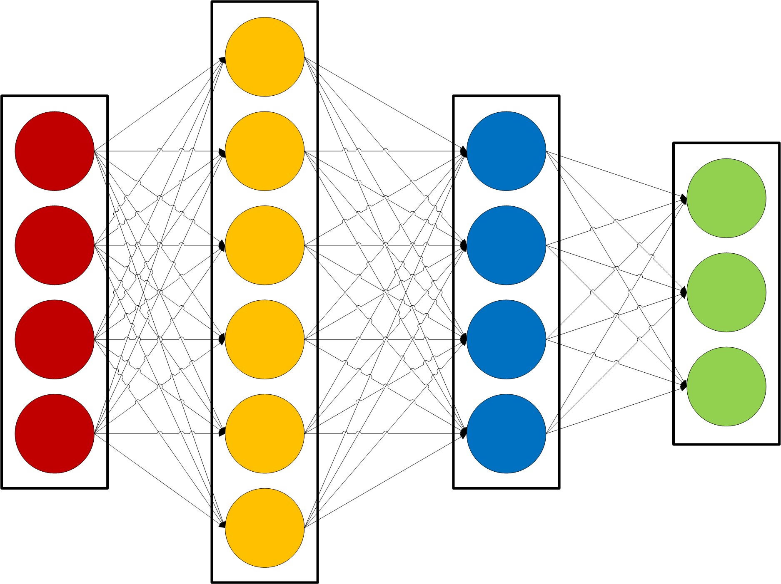

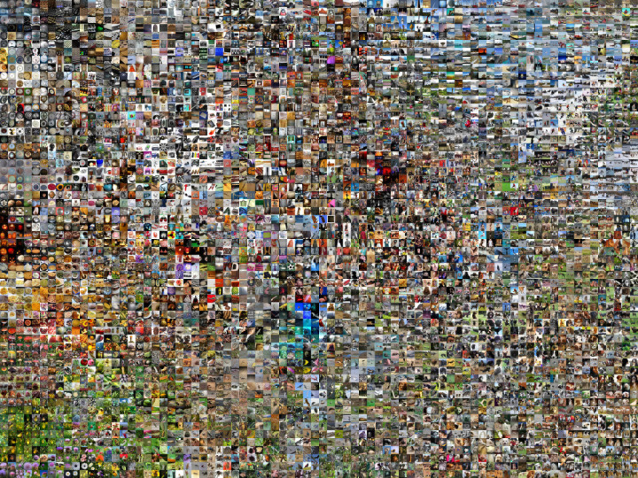
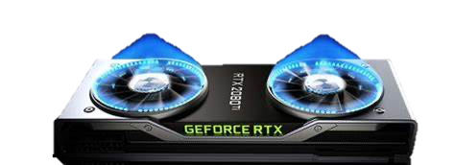
AI 模型训练代价高昂
Google
BERT
$160万
大规模、高性能的AI模型训练耗费巨大
数据资源
计算资源
人力资源

Slide 39






模型窃取的动机
模型窃取
为其所用
巨大的商业价值
尽量保持模型性能
不希望被发现
宝贵的 AI 模型

Slide 40


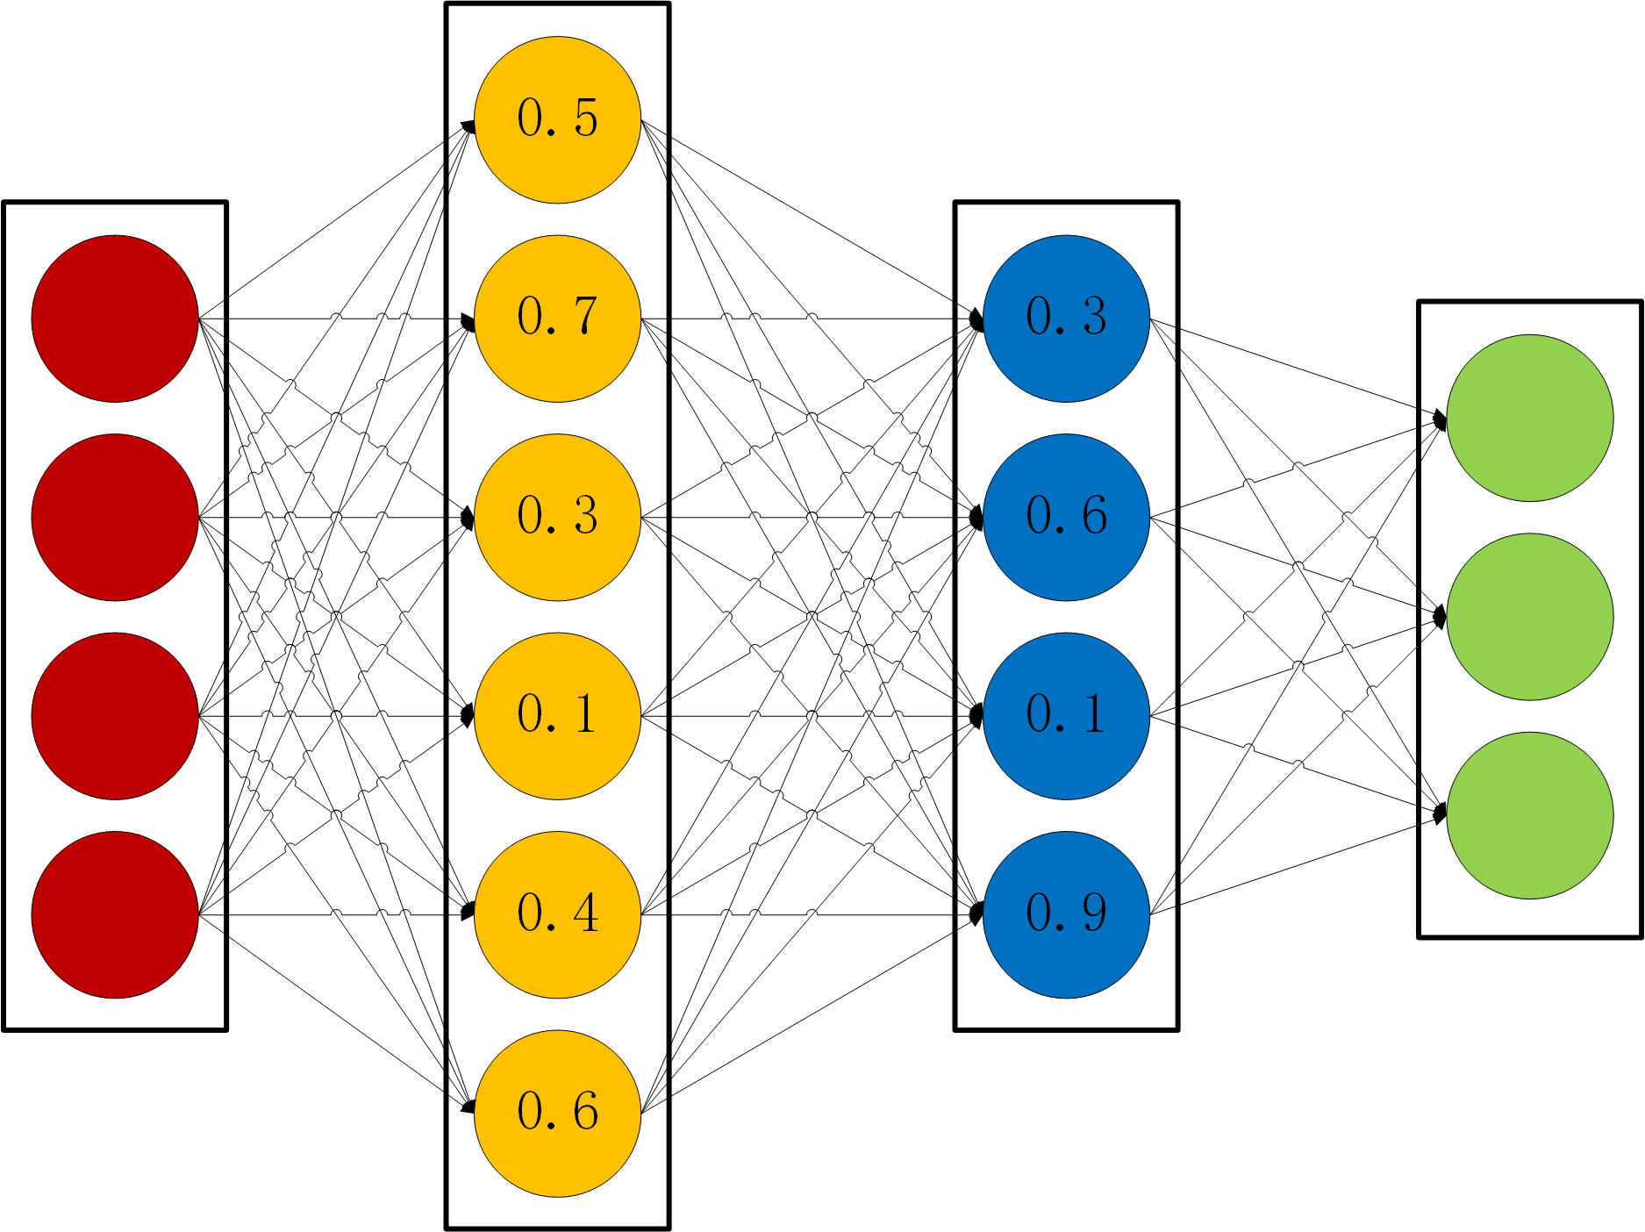

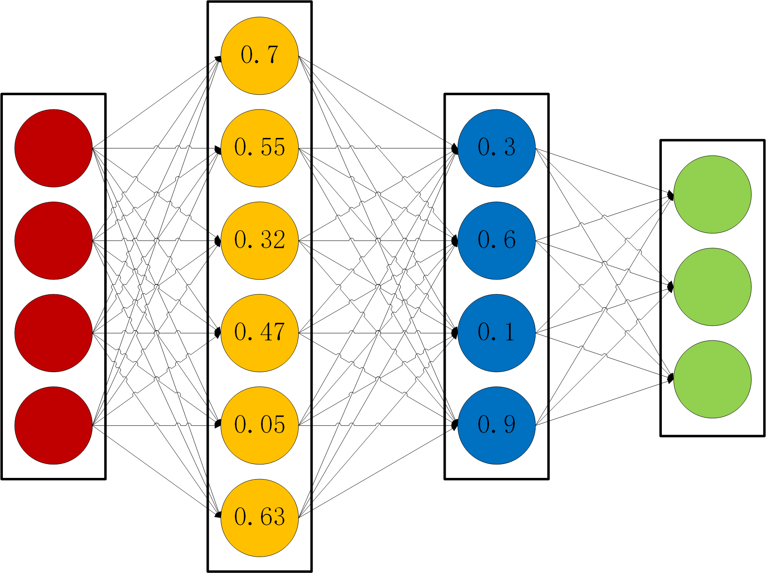
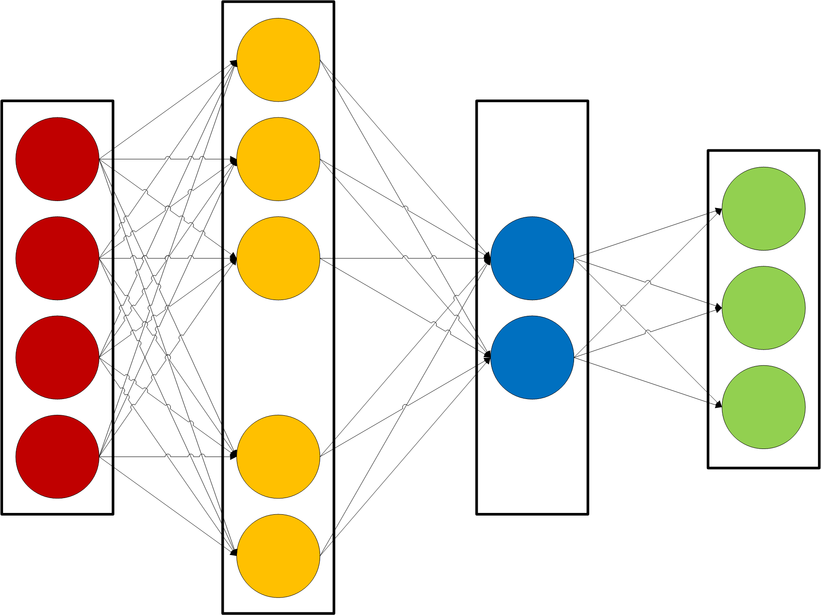

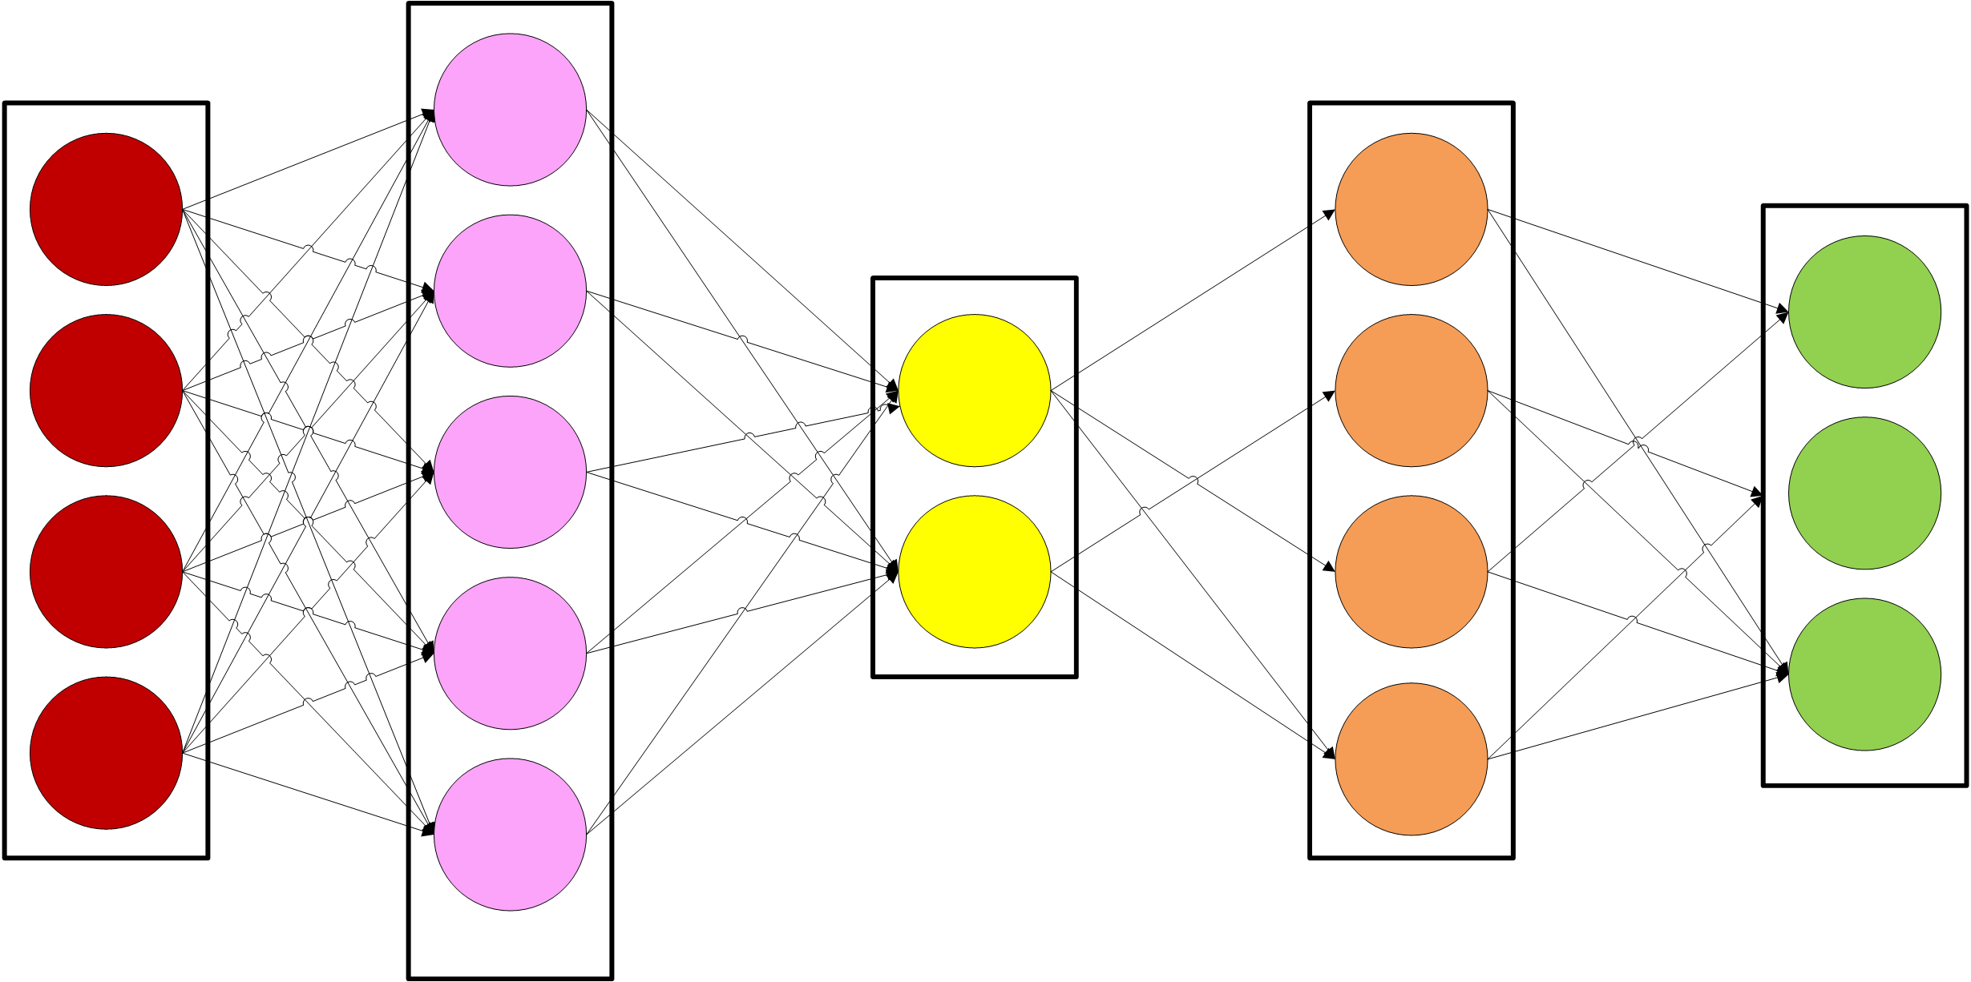
模型窃取的方式
模型微调
模型剪枝
输入
窃取攻击
输出
Stealing machine learning models via prediction APIs, USENIX Security, 2016; Practical black-box attacks against machine learning, ASIACCS, 2017; Knockoff nets: Stealing functionality of black-box models, CVPR, 2019; Maze: Data-free model stealing attack using zeroth-order gradient estimation, CVPR, 2021;

Slide 41
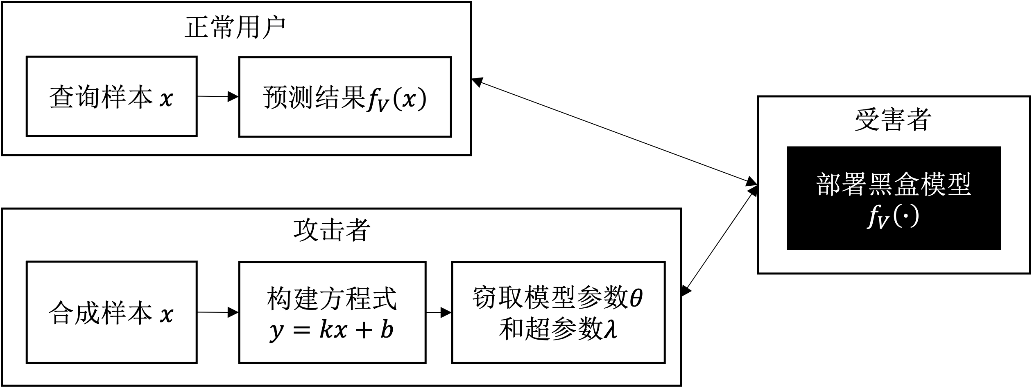
基于方程式求解的攻击
攻击思路示例

Slide 42
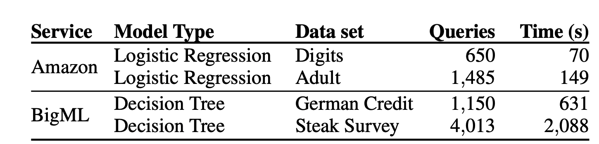
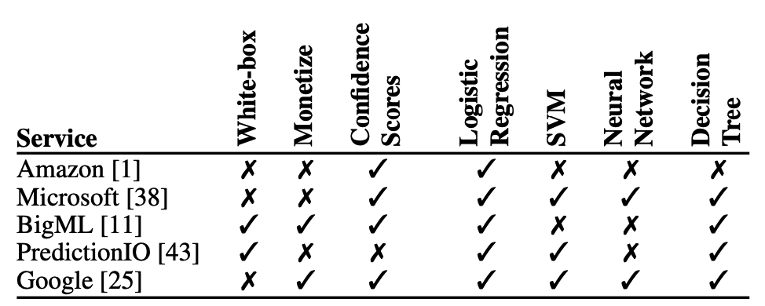
基于方程式求解的攻击
100%窃取某些商业模型所需的查询数和时间
Tramèr, Florian, et al. "Stealing machine learning models via prediction {APIs}." USENIX Security, 2016.

Slide 43
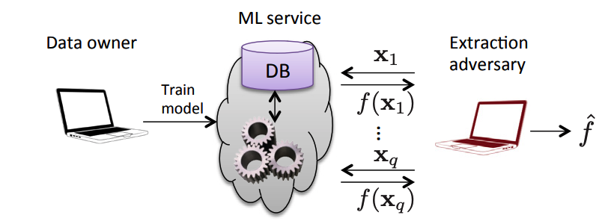


基于方程式求解的攻击：窃取参数
攻击算法
参数个数为d
通过d+1个输入，构造d+1个下列方程
求解方程得到$θ$
主要特点：
针对传统机器学习模型:SVM、LR、DT
可精确求解，需要模型返回精确的置信度
窃取得到的模型还可能泄露训练数据（数据逆向攻击）
Tramèr, Florian, et al. "Stealing machine learning models via prediction {APIs}." USENIX Security, 2016.

Slide 44






基于方程式求解的攻击：窃取超参
攻击思想：模型训练完了的状态应该是Loss梯度为0
窃取超参数$λ$
主要特点：
需要知道Loss的形式
需要在所有数据上做矩阵运算
R只与模型参数$θ$有关
Wang, Binghui, and Neil Zhenqiang Gong. "Stealing hyperparameters in machine learning." S&P, 2018.

Slide 45

基于替代模型的攻击
攻击思想：在查询目标模型的过程中训练一个替代模型模拟其行为
Orekondy et al. "Knockoff nets: Stealing functionality of black-box models." CVPR, 2019.

Slide 46

基于替代模型的攻击
Knockoff Nets 攻击：“仿冒网络”
Orekondy et al. "Knockoff nets: Stealing functionality of black-box models." CVPR, 2019.

Slide 47



基于替代模型的攻击
Knockoff Nets 攻击：攻击流程
训练替代模型
强化学习，学习如何高效选择样本
采样大量查询样本
Orekondy et al. "Knockoff nets: Stealing functionality of black-box models." CVPR, 2019.

Slide 48

基于替代模型的攻击
高准确 （accuracy） vs 高保真 （fidelity） 窃取攻击
蓝色：目标决策边界
橙色：高准确窃取
绿色：高保真窃取
Jagielski, Matthew, et al. “High accuracy and high fidelity extraction of neural networks.” USENIX Security, 2020.

Slide 49




基于替代模型的攻击
高准确 （accuracy） vs 高保真 （fidelity） 窃取攻击
查询图片
目标模型（黑盒）
概率输出
模型输出作为标签
类别输出
指导替代模型训练
替代模型
替代模型的训练$≈$知识蒸馏
Jagielski, Matthew, et al. “High accuracy and high fidelity extraction of neural networks.” USENIX Security, 2020.

Slide 50


基于替代模型的攻击
功能等同窃取Functionally Equivalent Extraction
攻击步骤：
寻找在某个Neuron上，让ReLU=0的关键点
在关键点两侧探索边界，确定对应权重
只能窃取两层网络
Jagielski, Matthew, et al. “High accuracy and high fidelity extraction of neural networks.” USENIX Security, 2020.

Slide 51

基于替代模型的攻击
加密分析窃取Cryptanalytic Extraction
ReLU=0
思想：ReLU的二级导为0 & 有限差分（finite difference）
Carlini et al. "Cryptanalytic extraction of neural network models." Annual International Cryptology Conference, 2020.

Slide 52


基于替代模型的攻击
加密分析窃取 Cryptanalytic Extraction
窃取0-deep神经网络：
窃取1-deep神经网络：
Carlini et al. "Cryptanalytic extraction of neural network models." Annual International Cryptology Conference, 2020.

Slide 53

基于替代模型的攻击
估计合成攻击 Estimation Synthesis (ES) Attack
思想：初始化合成数据集，然后根据模型返回训练替代模型
E-step：在合成数据上知识蒸馏更新替代模型
S-step：合成数据，使用对抗生成网络（GAN）
特点：
不需要原始训练数据或先验
不需要目标模型先验
Yuan, Xiaoyong, et al. “ES attack: Model stealing against deep neural networks without data hurdles.” 2022.

Slide 54

基于替代模型的攻击
ES攻击算法: 蒸馏+生成的结合

Slide 55

基于替代模型的攻击
ES攻击合成的数据分布
train:原始训练数据
aux:公共数据集
syn:合成数据集

Slide 56


基于侧信道攻击的窃取
侧信道（side-channel）攻击窃取神经网络
通过探测运行神经网络的微处理器的电力使用情况，来窃取神经网络的权重
Batina et al. CSI neural network: Using side-channels to recover your artificial neural network information, USENIX Security, 2019

Slide 57


LLM Extraction
基于LLAMA 7B模拟ChatGPT
斯坦福仅用600美元就完成了对ChatGPT的窃取，其通过跟OpenAI的text-davinci-003对话，抽取52000个对话样本，再微调Meta的开源LLaMA 7B语言模型得到Alpaca
https://crfm.stanford.edu/2023/03/13/alpaca.html

Slide 58

LLM Extraction
LLaMa 7B -> Alpaca 7B
https://crfm.stanford.edu/2023/03/13/alpaca.html

Slide 59
Future Research
Attack:
Data/model extraction attacks on LLMs
Attacking large-scale datasets and models
Defense:
Attack detection and mitigation: detect malicious queries
Attack as a defense, adding watermark/backdoor into the extracted data

Slide 60
谢谢！

